Slide 1

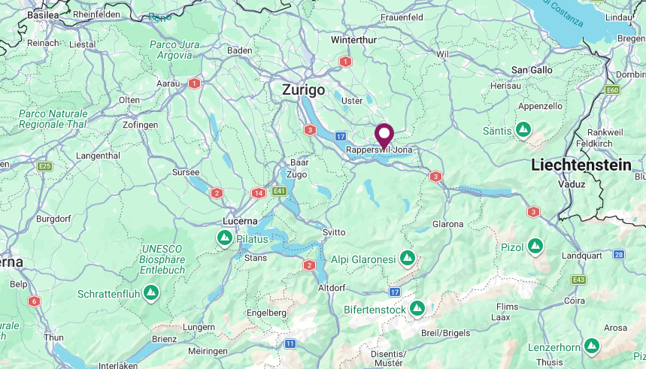
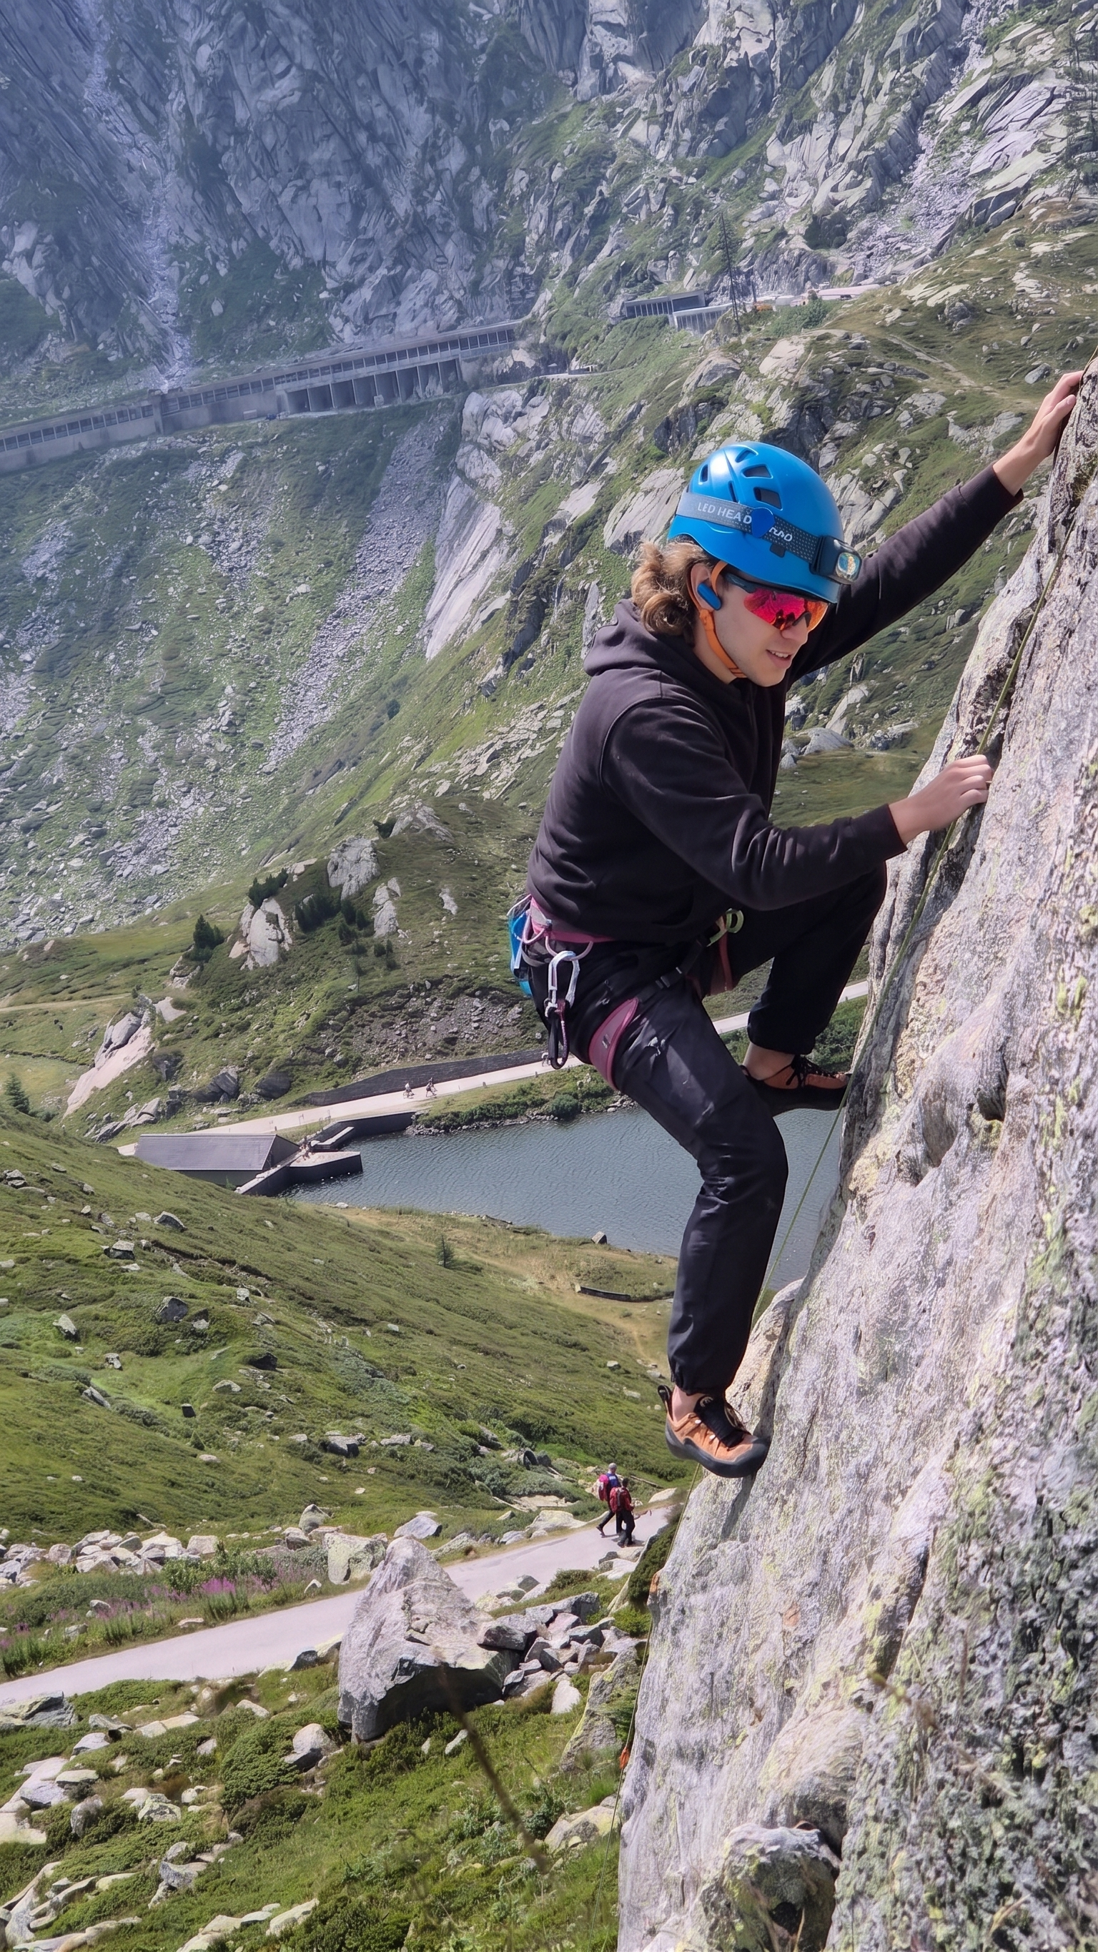
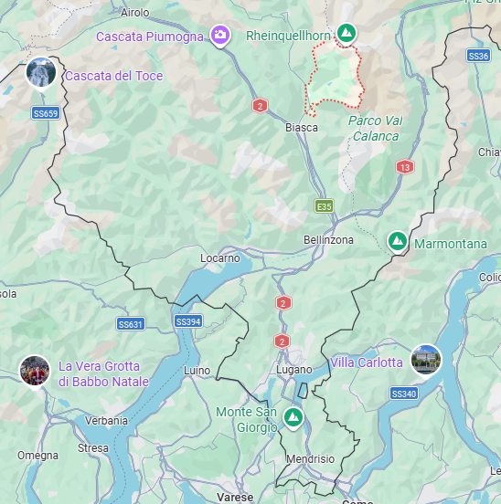



Aaron Ricca
University: Eastern Switzerland University of Applied Sciences (OST)
Study program: Eletrical and Computer Engineering
Year of study: 7th Semester
City: Rapperswil, Switzerland
Motto for life: Bolts are the murder of the impossible.
Hobbies: Climbing, Anime, and Climbing again
Your expectations from the summer school:
Meet new people from all over the world and learn new things about Everything.
Rapperswil, Switzerland
Location where I live ↑,
Location of my origin ↓
Ticino, Switzerland
Karlsruhe
31 August to 11 September 2026

